Slide 1
120 Years of Olympic History- SQL Project

Slide 2
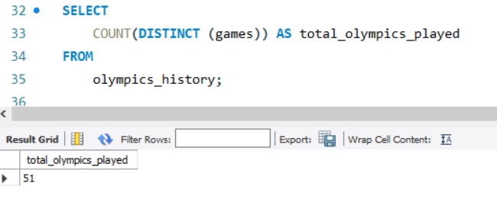
1. How many olympics games have been held?

Slide 3
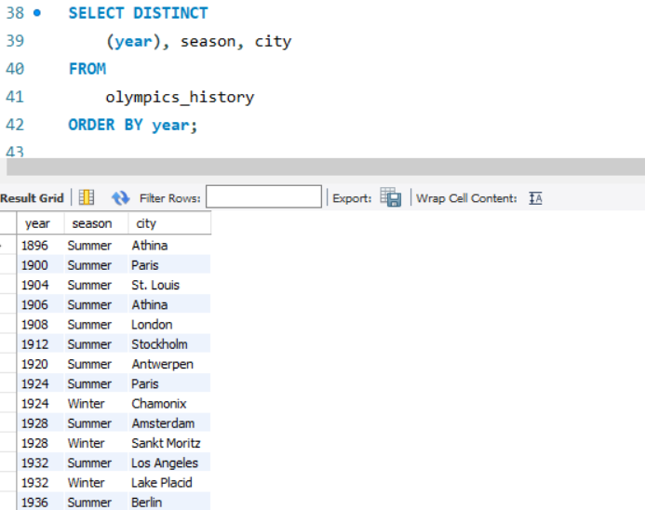
2. List down all Olympics games held so far.

Slide 4
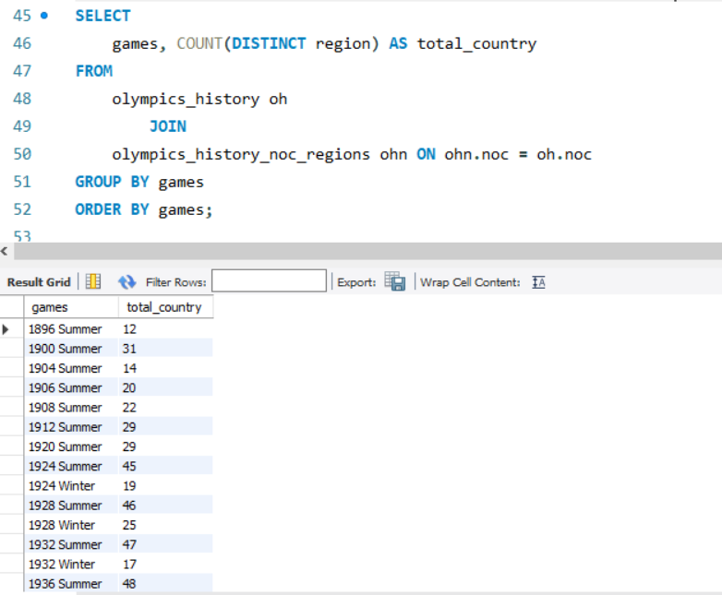
3. Mention the total no of nations who participated in each olympics game?

Slide 5
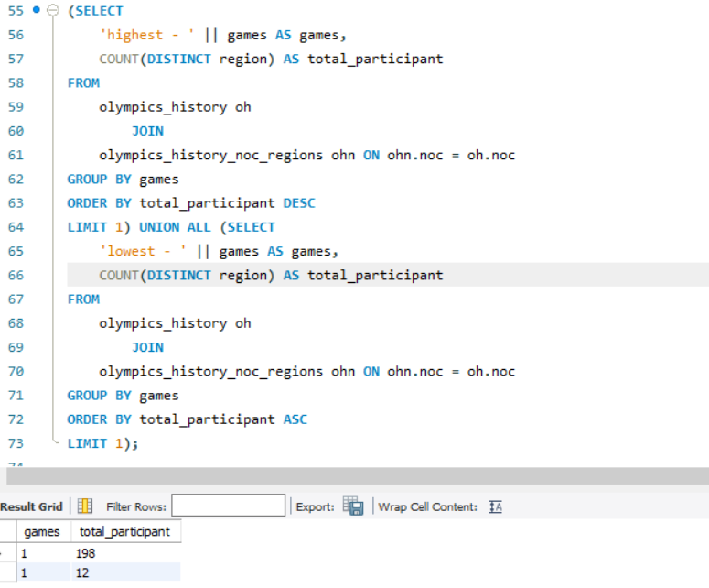
4. Which year saw the highest and lowest no of countries participating in olympics

Slide 6
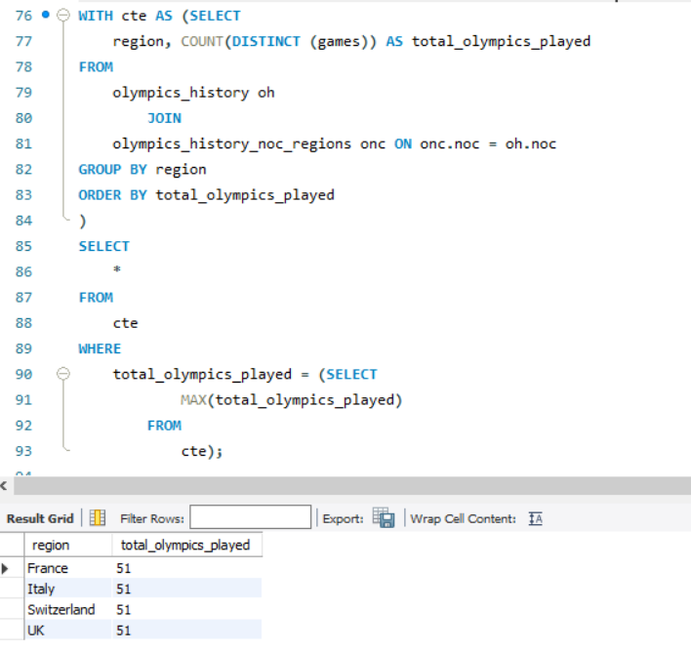
5. Which nation has participated in all of the olympic games

Slide 7
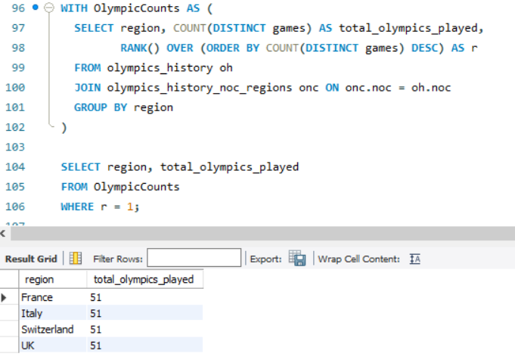
5. Which nation has participated in all of the olympic games – Using Window Func

Slide 8
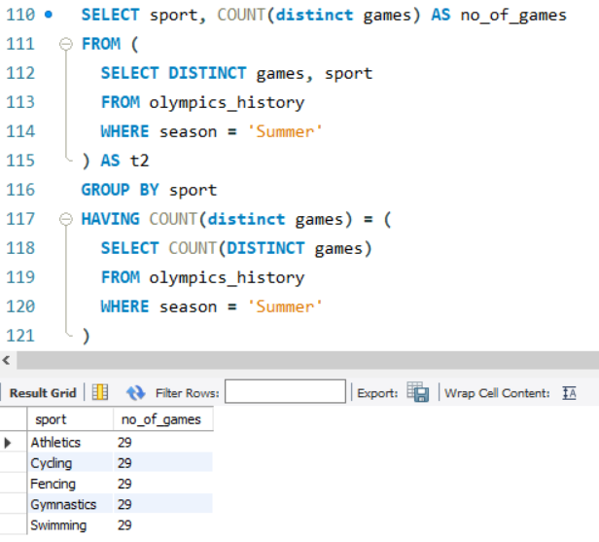
6. Identify the sport which was played in all summer olympics.

Slide 9
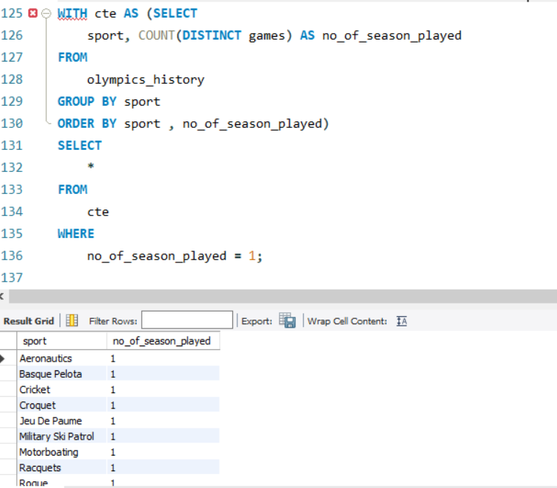
7. Which Sports were just played only in one olympics season.

Slide 10
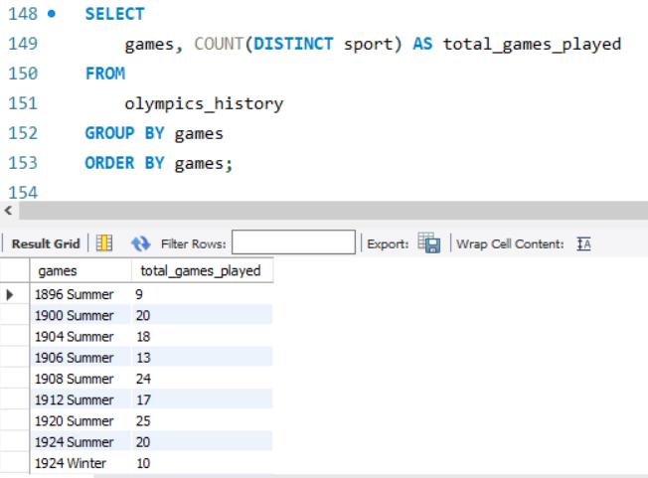
8. Fetch the total no of sports played in each olympic games.

Slide 11
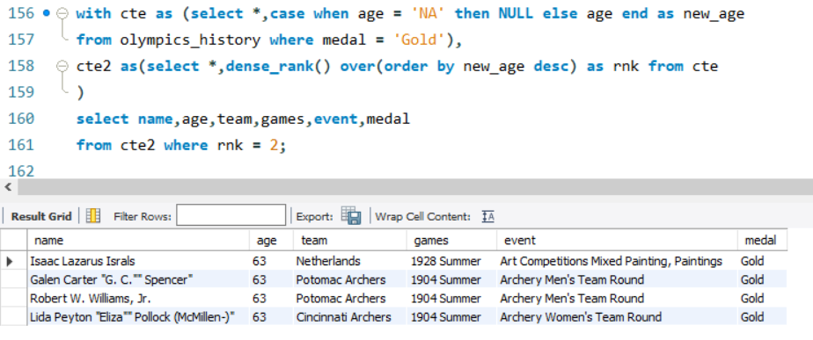
9. Fetch oldest athletes to win a gold medal

Slide 12
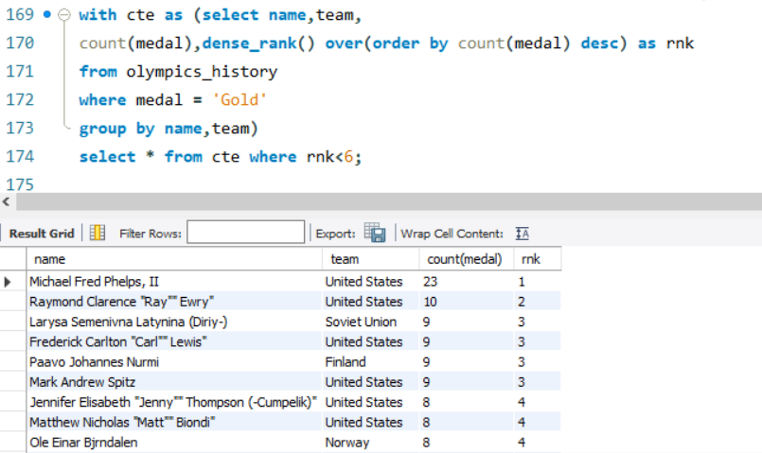
10. Fetch the top 5 athletes who have won the most gold medals.

Slide 13
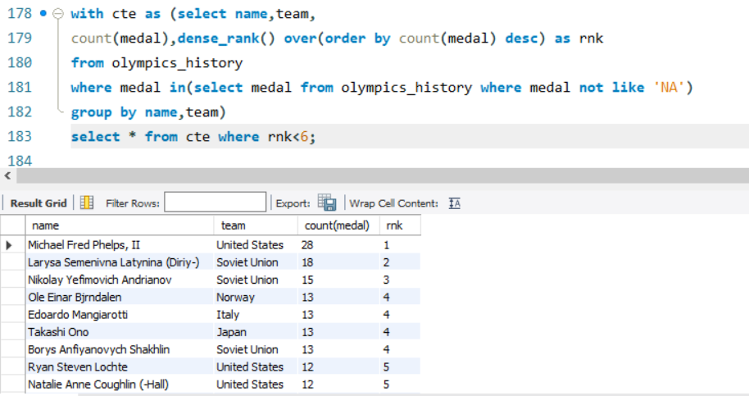
11. Fetch the top 5 athletes who have won the most medals (gold/silver/bronze).

Slide 14
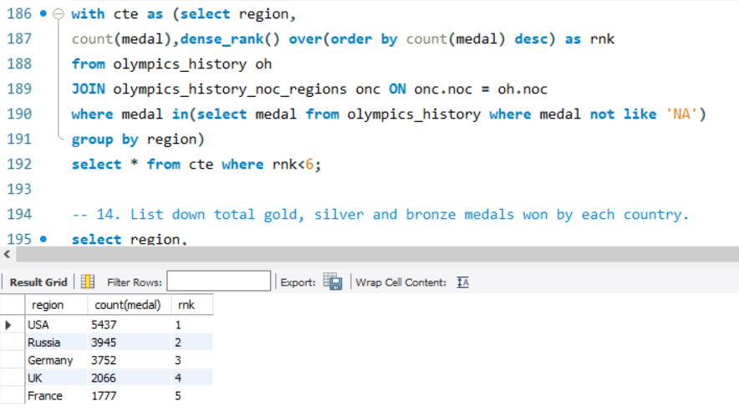
12. Fetch the top 5 most successful countries in olympics. Success is defined by no of medals won.

Slide 15
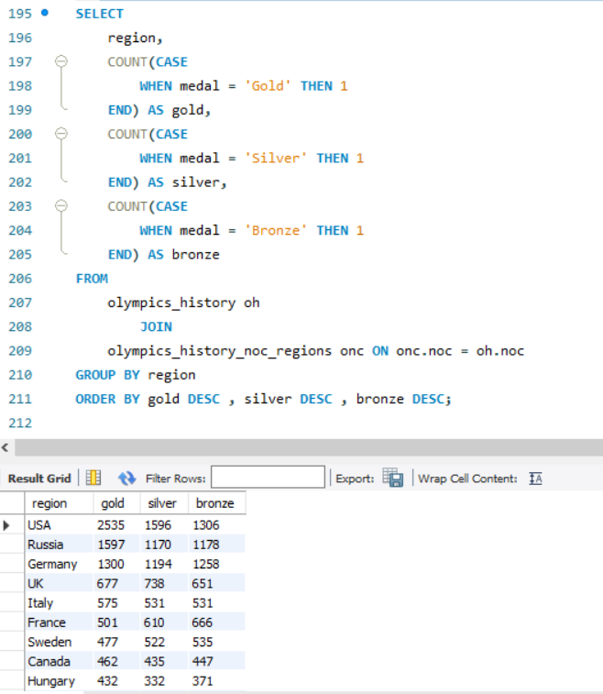
13. List down total gold, silver and bronze medals won by each country.

Slide 16
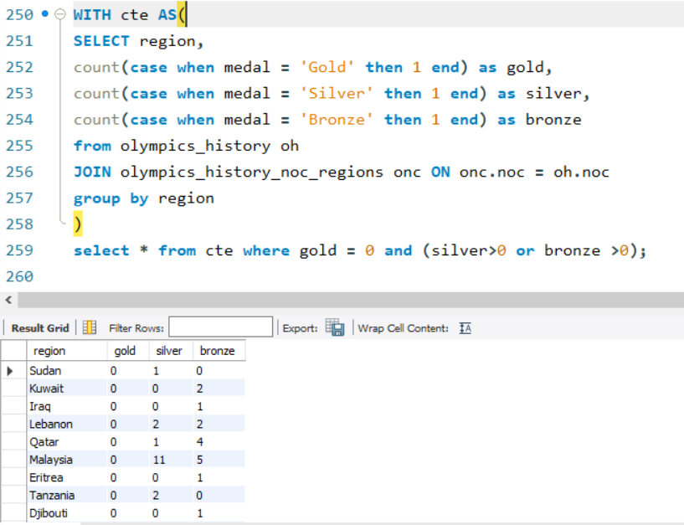
14. Which countries have never won gold medal but have won silver/bronze medals?

Slide 17
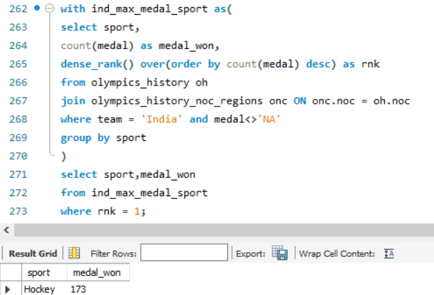
15. In which Sport/event, India has won highest medals.

Slide 18
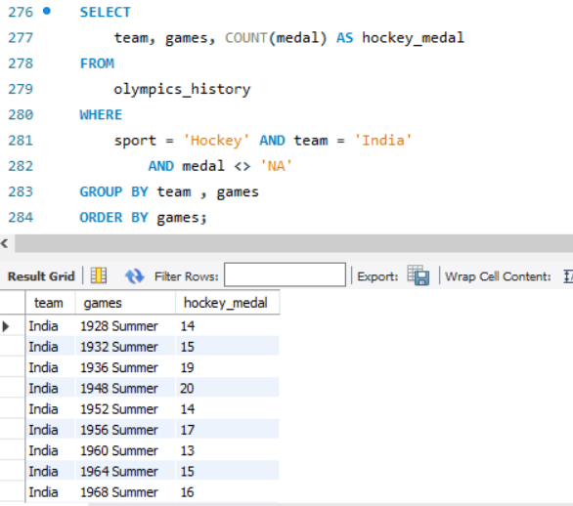
16. Break down all olympic games where India won medal for Hockey and how many medals in each olympic games

